Slide 1
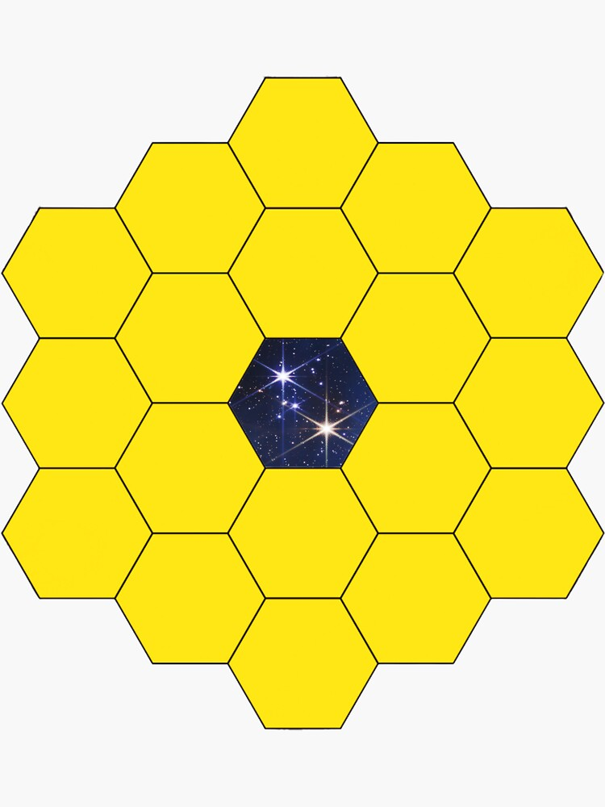
Data Reduction (JWST-NIRSpec)
Ahmad Al-Imtiaz
Department of Physics, SUST
Ex. President, 9th EC, CAM-SUST
https://www.iac.es/en/

Slide 2
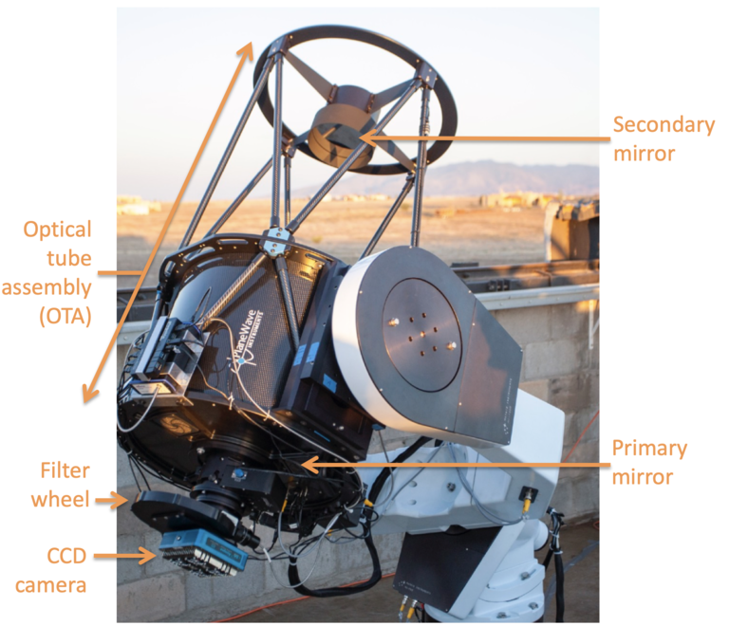
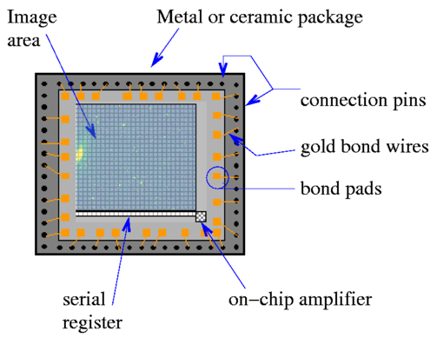
Projection on CCD

Slide 3
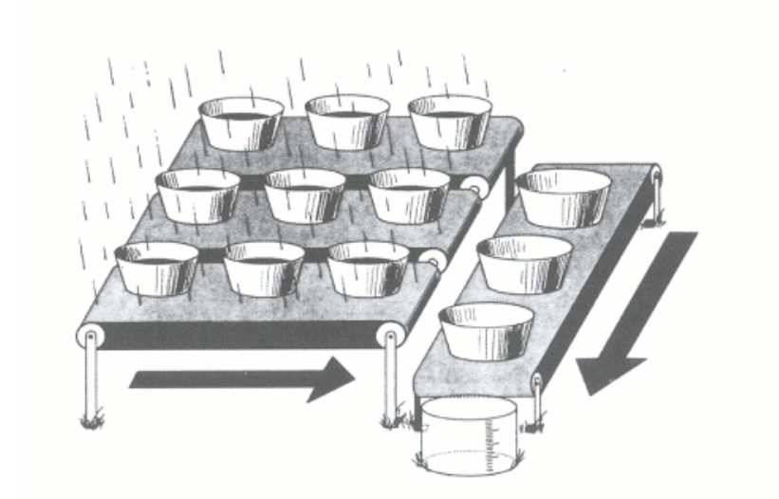
Basic CCD mechanism

Slide 4
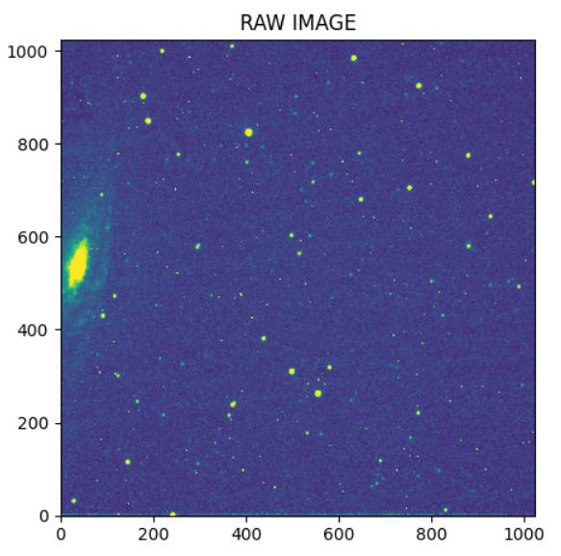
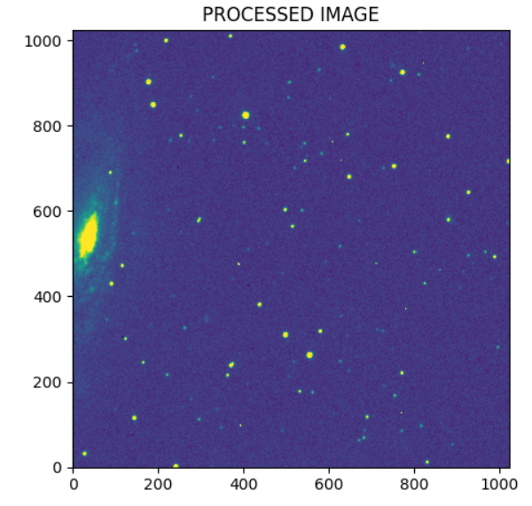
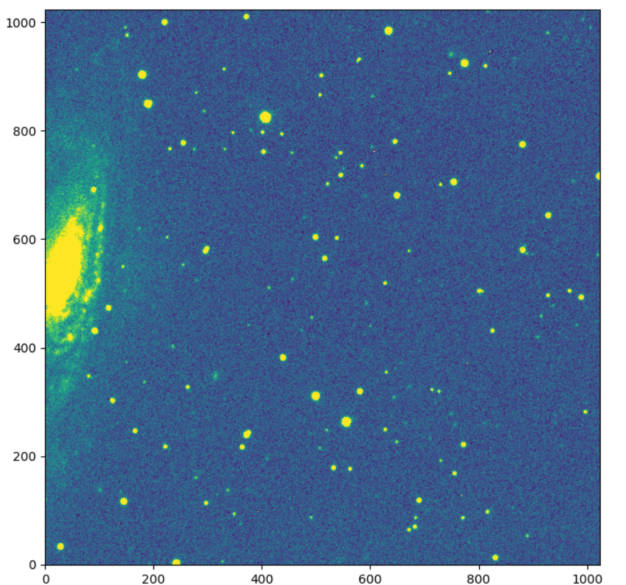
What’s our target on this workshop?
Raw Image
Reduced Single Image
Combine Image

Slide 5
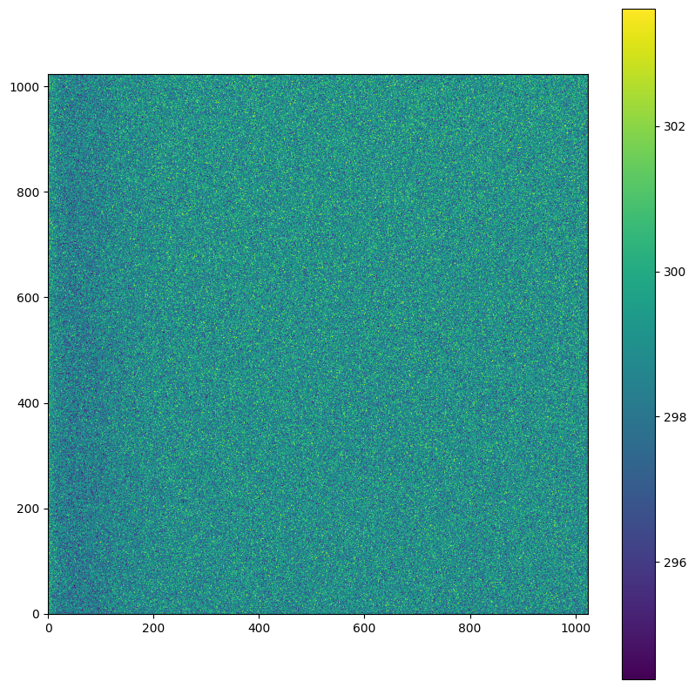
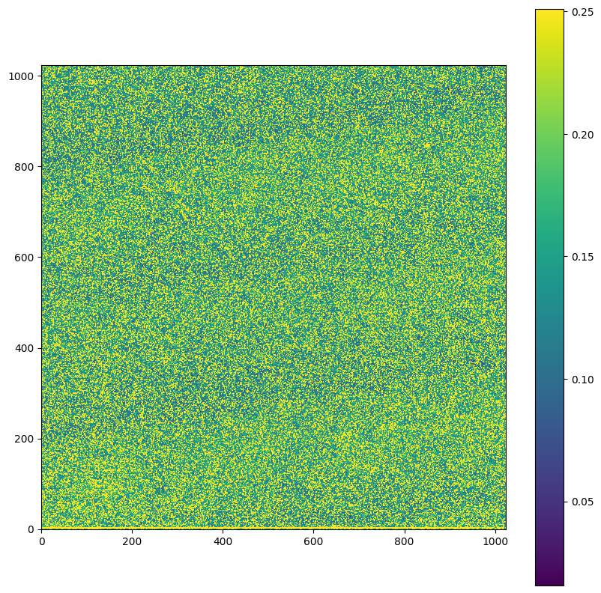
Sources noise during an observation
BIAS: A zero second exposure used to measure the “no signal” noise level of the detector during the starting of an observation. This is a fixed offset level applied to all data.
DARK: An image while the shutter is closed (dark) for the same time as the planned science exposure time

Slide 6
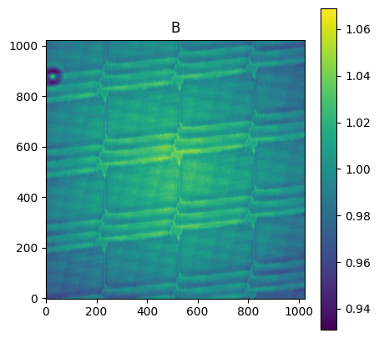
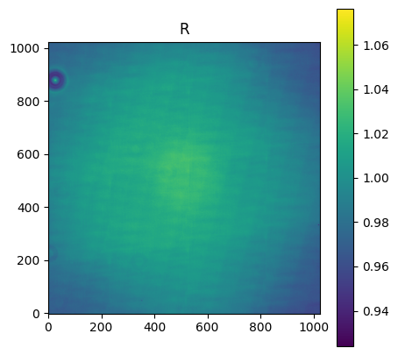
Sources noise during an observation
FLAT: The pixel-to-pixel sensitivity of the detector is not constant. Also, flat is wavelength dependent.

Slide 7
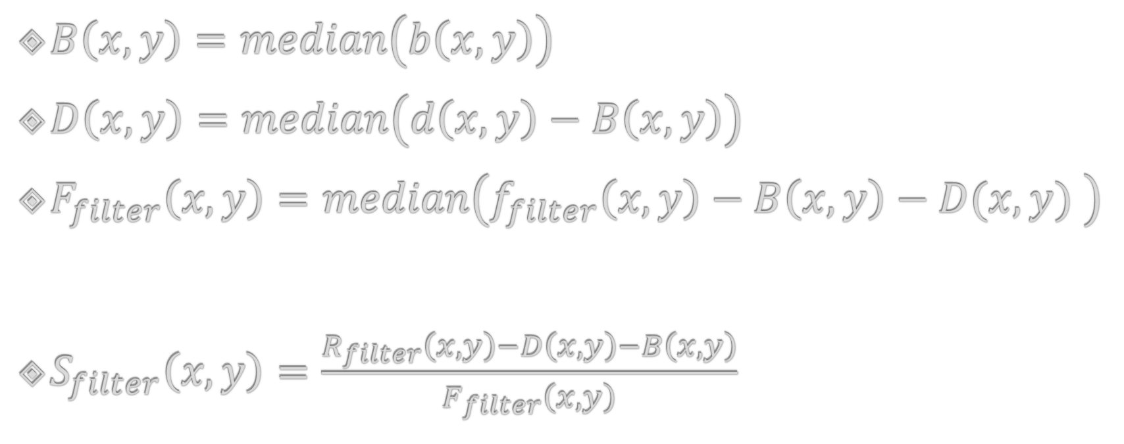
Data reduction steps
$B\left(x,y\right)=median\left(b\left(x,y\right)\right)$
$D\left(x, y\right)=median\left(d\left(x,y\right)−B\left(x,y\right)\right)$
$F_{filter}\left(x,y\right)=median\left(f_{filter}\left(x,y\right)−B\left(x,y\right)−D(x,y) \right)$
$S_{filter}\left(x,y\right)=\frac{R_{filter}\left(x,y\right)−D\left(x,y\right)−B\left(x,y\right)}{F_{filter}\left(x,y\right)}$

Slide 8
Spectrum

Slide 9
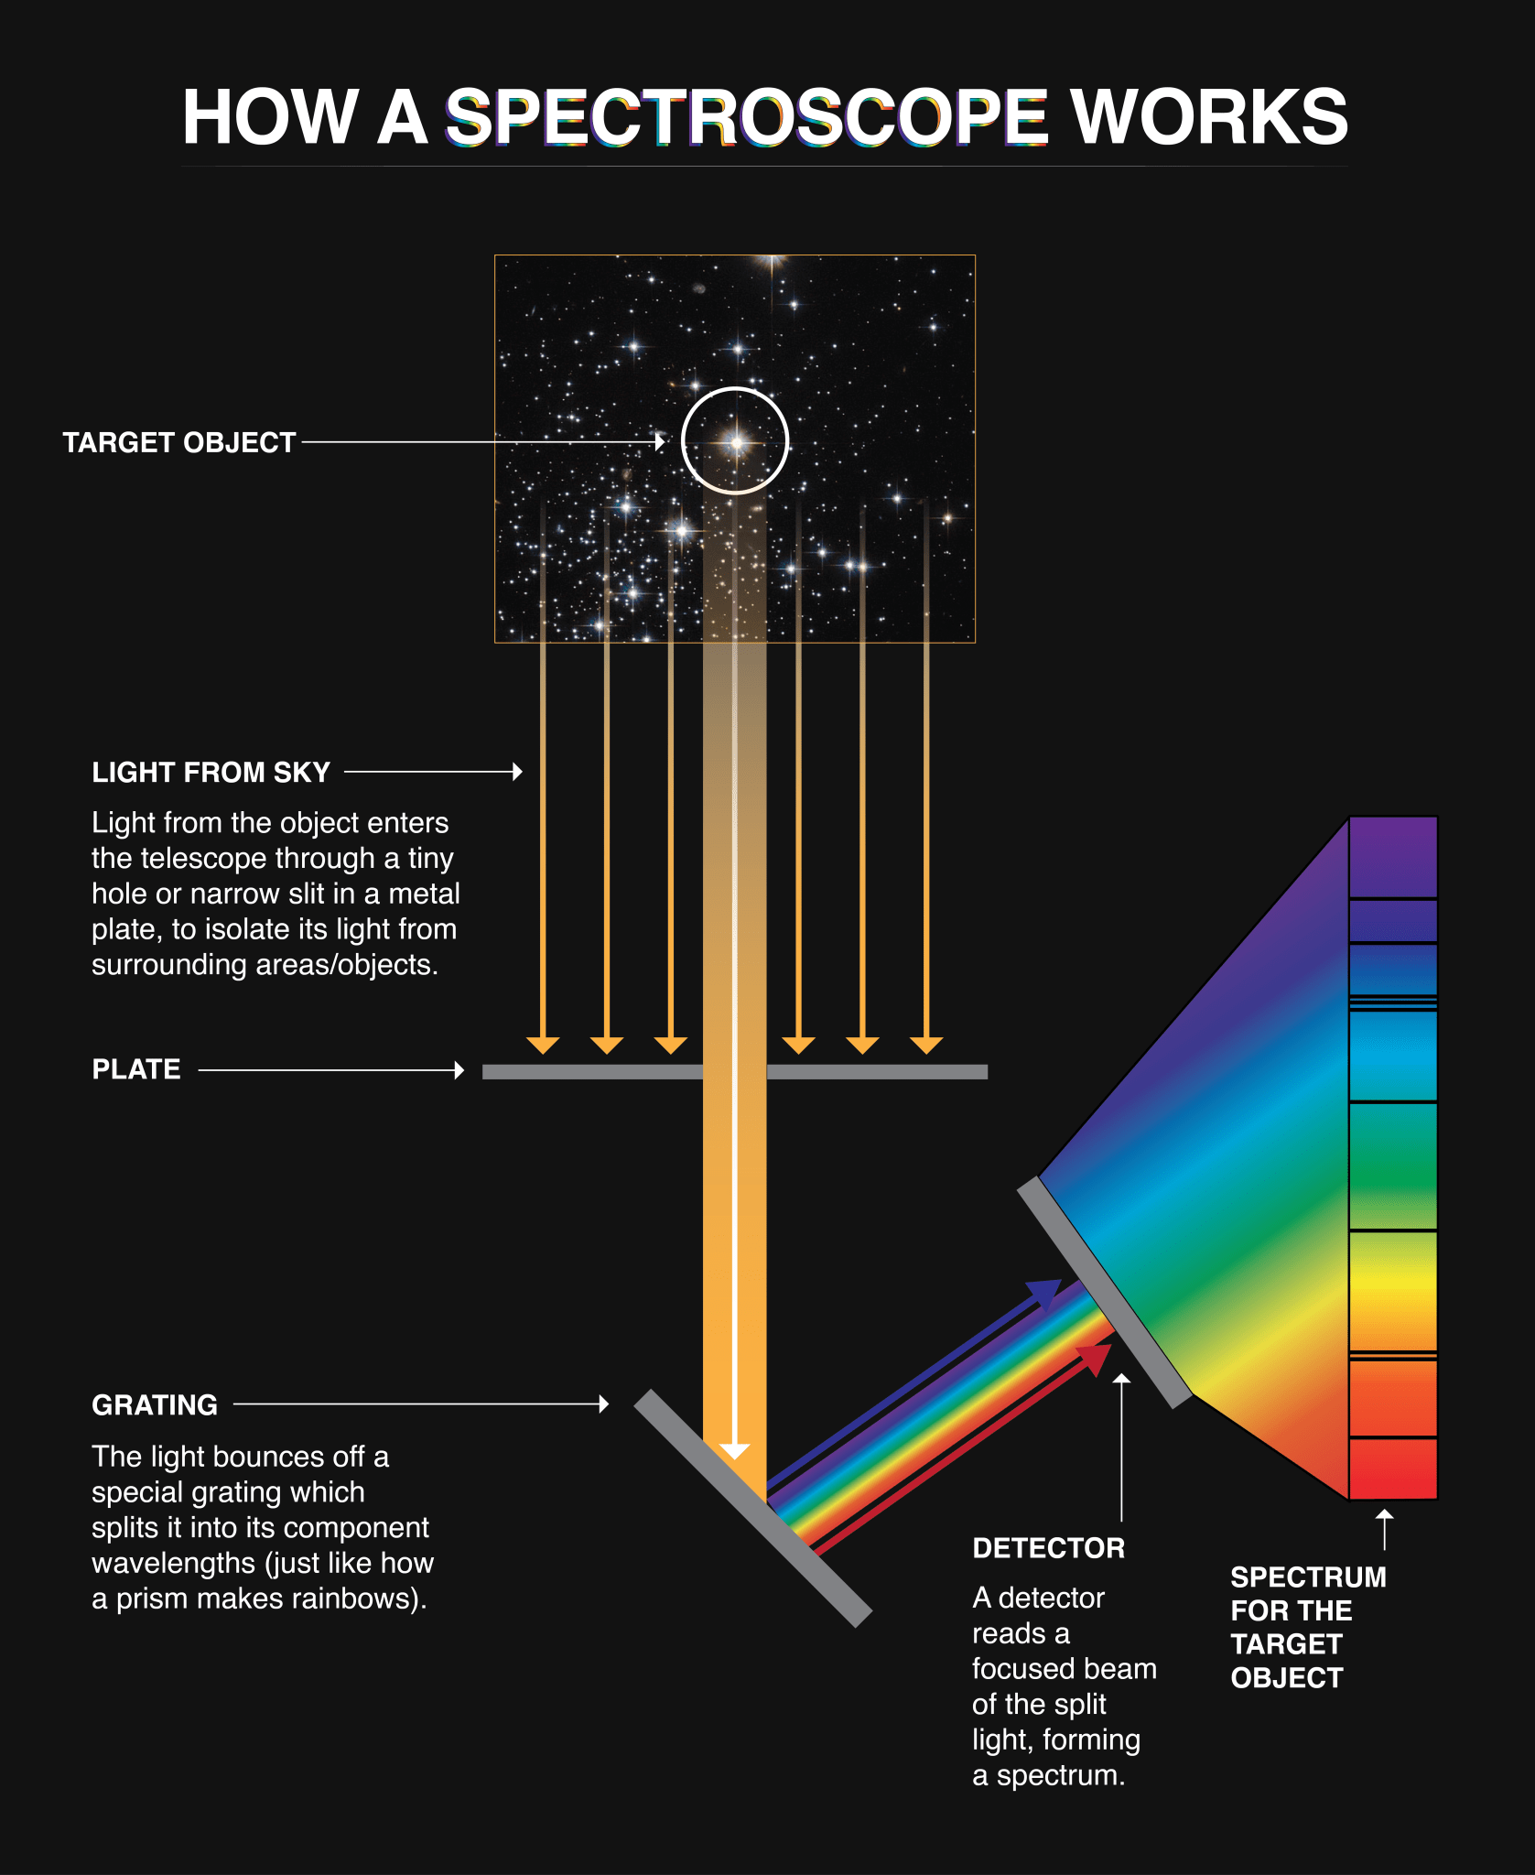
What Spectra can tell us?
Chemical Composition
Object’s Temperature
Density
Motion
Distance
Hubble Spectroscopy - NASA Science

Slide 10
JWST NIRSpec
Go to: JWST NIRSpec - NASA Science
Description — jwst 1.19.0rc1.dev370+gd6eb349a4 documentation
calwebb_detector1: Stage 1 Detector Processing — jwst 1.19.0rc1.dev368+g5c86e9b6c documentation
calwebb_spec2: Stage 2 Spectroscopic Processing — jwst 1.19.0rc1.dev370+gd6eb349a4 documentation
calwebb_spec3: Stage 3 Spectroscopic Processing — jwst 1.19.0rc1.dev370+gd6eb349a4 documentation

Slide 11
Thank You

Slide 12
Download these
SAOImageDS9
I have shared a drive link last night on the hands-on session’s channel (slack). Please download both folders (crds_cache & notebooks).

